Slide 1
DEAC Meeting: December 5, 2013 Post-Meeting Minutes
AchieveNJ and Evaluation Scoring Updates - Please read ahead of time
  Final Summative Rating Performance Levels are released for 2013-14
  SGP Scoring is released
Marzano Teacher Evaluation Instrument (Please bring Teacher Evaluation That Makes a Difference for Reference)
  Elements that will be scored in Domains 2, 3, 4
  Conjunctive vs. Average Scoring
  First Round Observation Check-In
Professional Learning/Development
  SGO monitoring
  February 18th – Full Day of PD
  Role of ScIP for each school

Slide 2
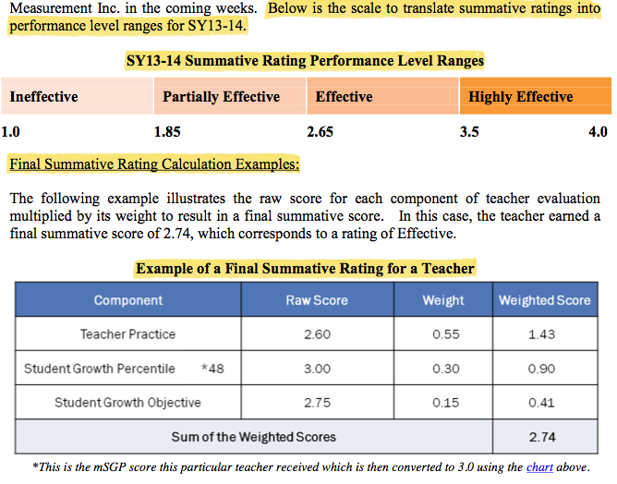
Final Summative Rating Performance Levels Ranges are Released

Slide 3
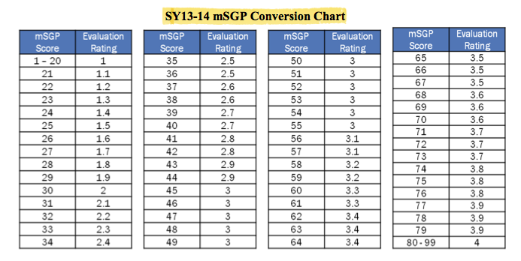
Student Growth Percentile Scoring is Released

Slide 4
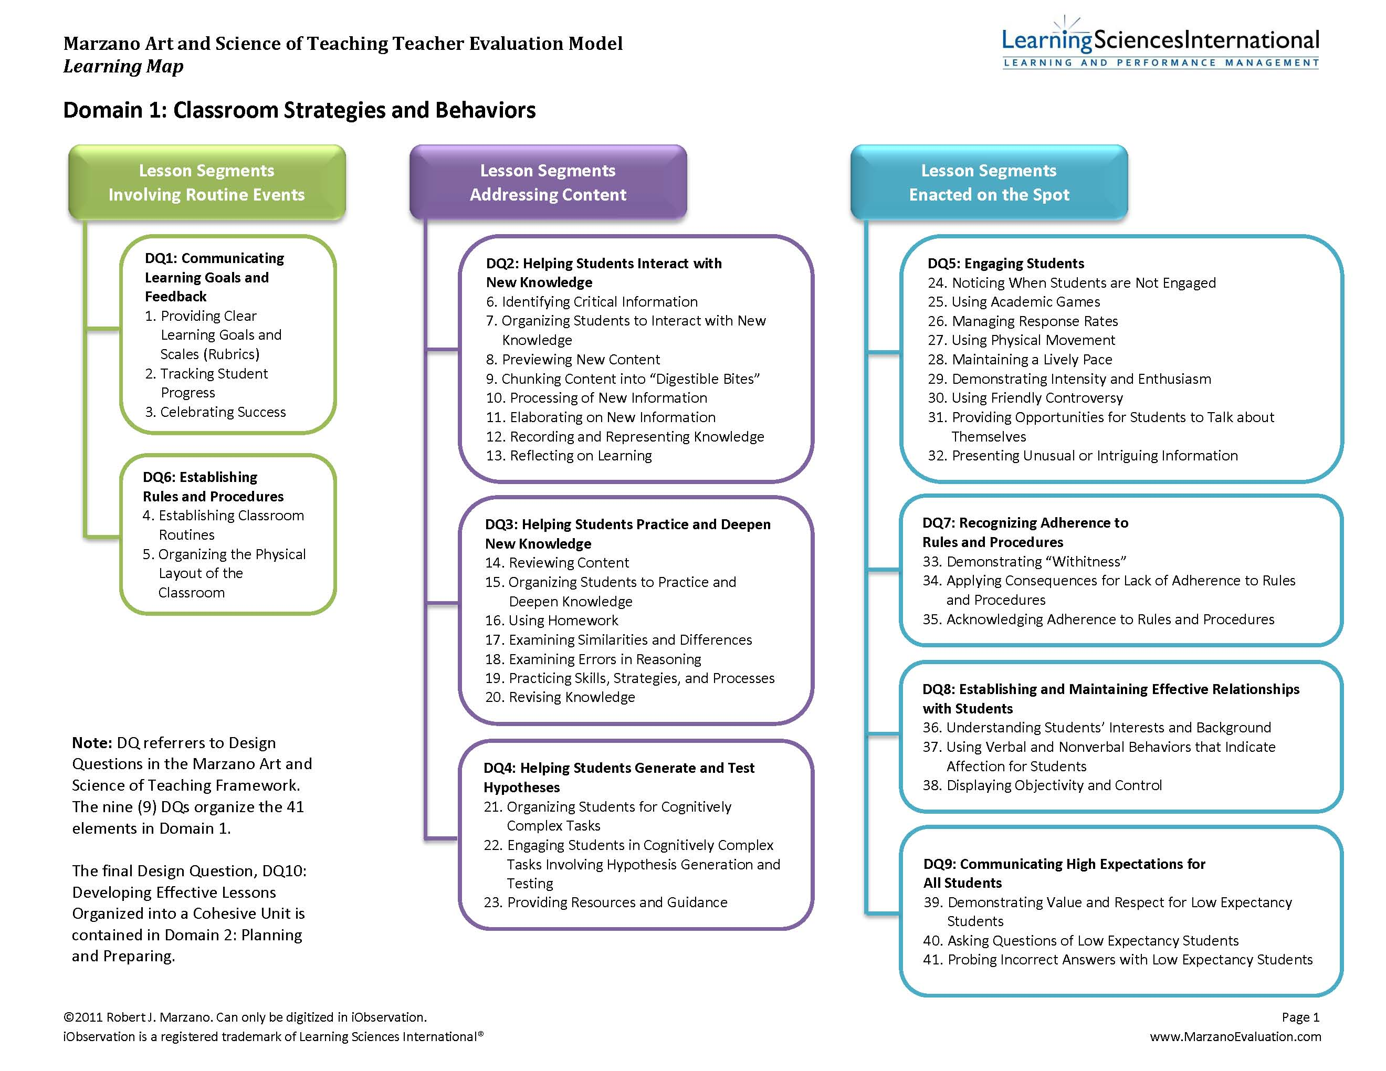
70%
*Updated Annual Evaluation*

Slide 5
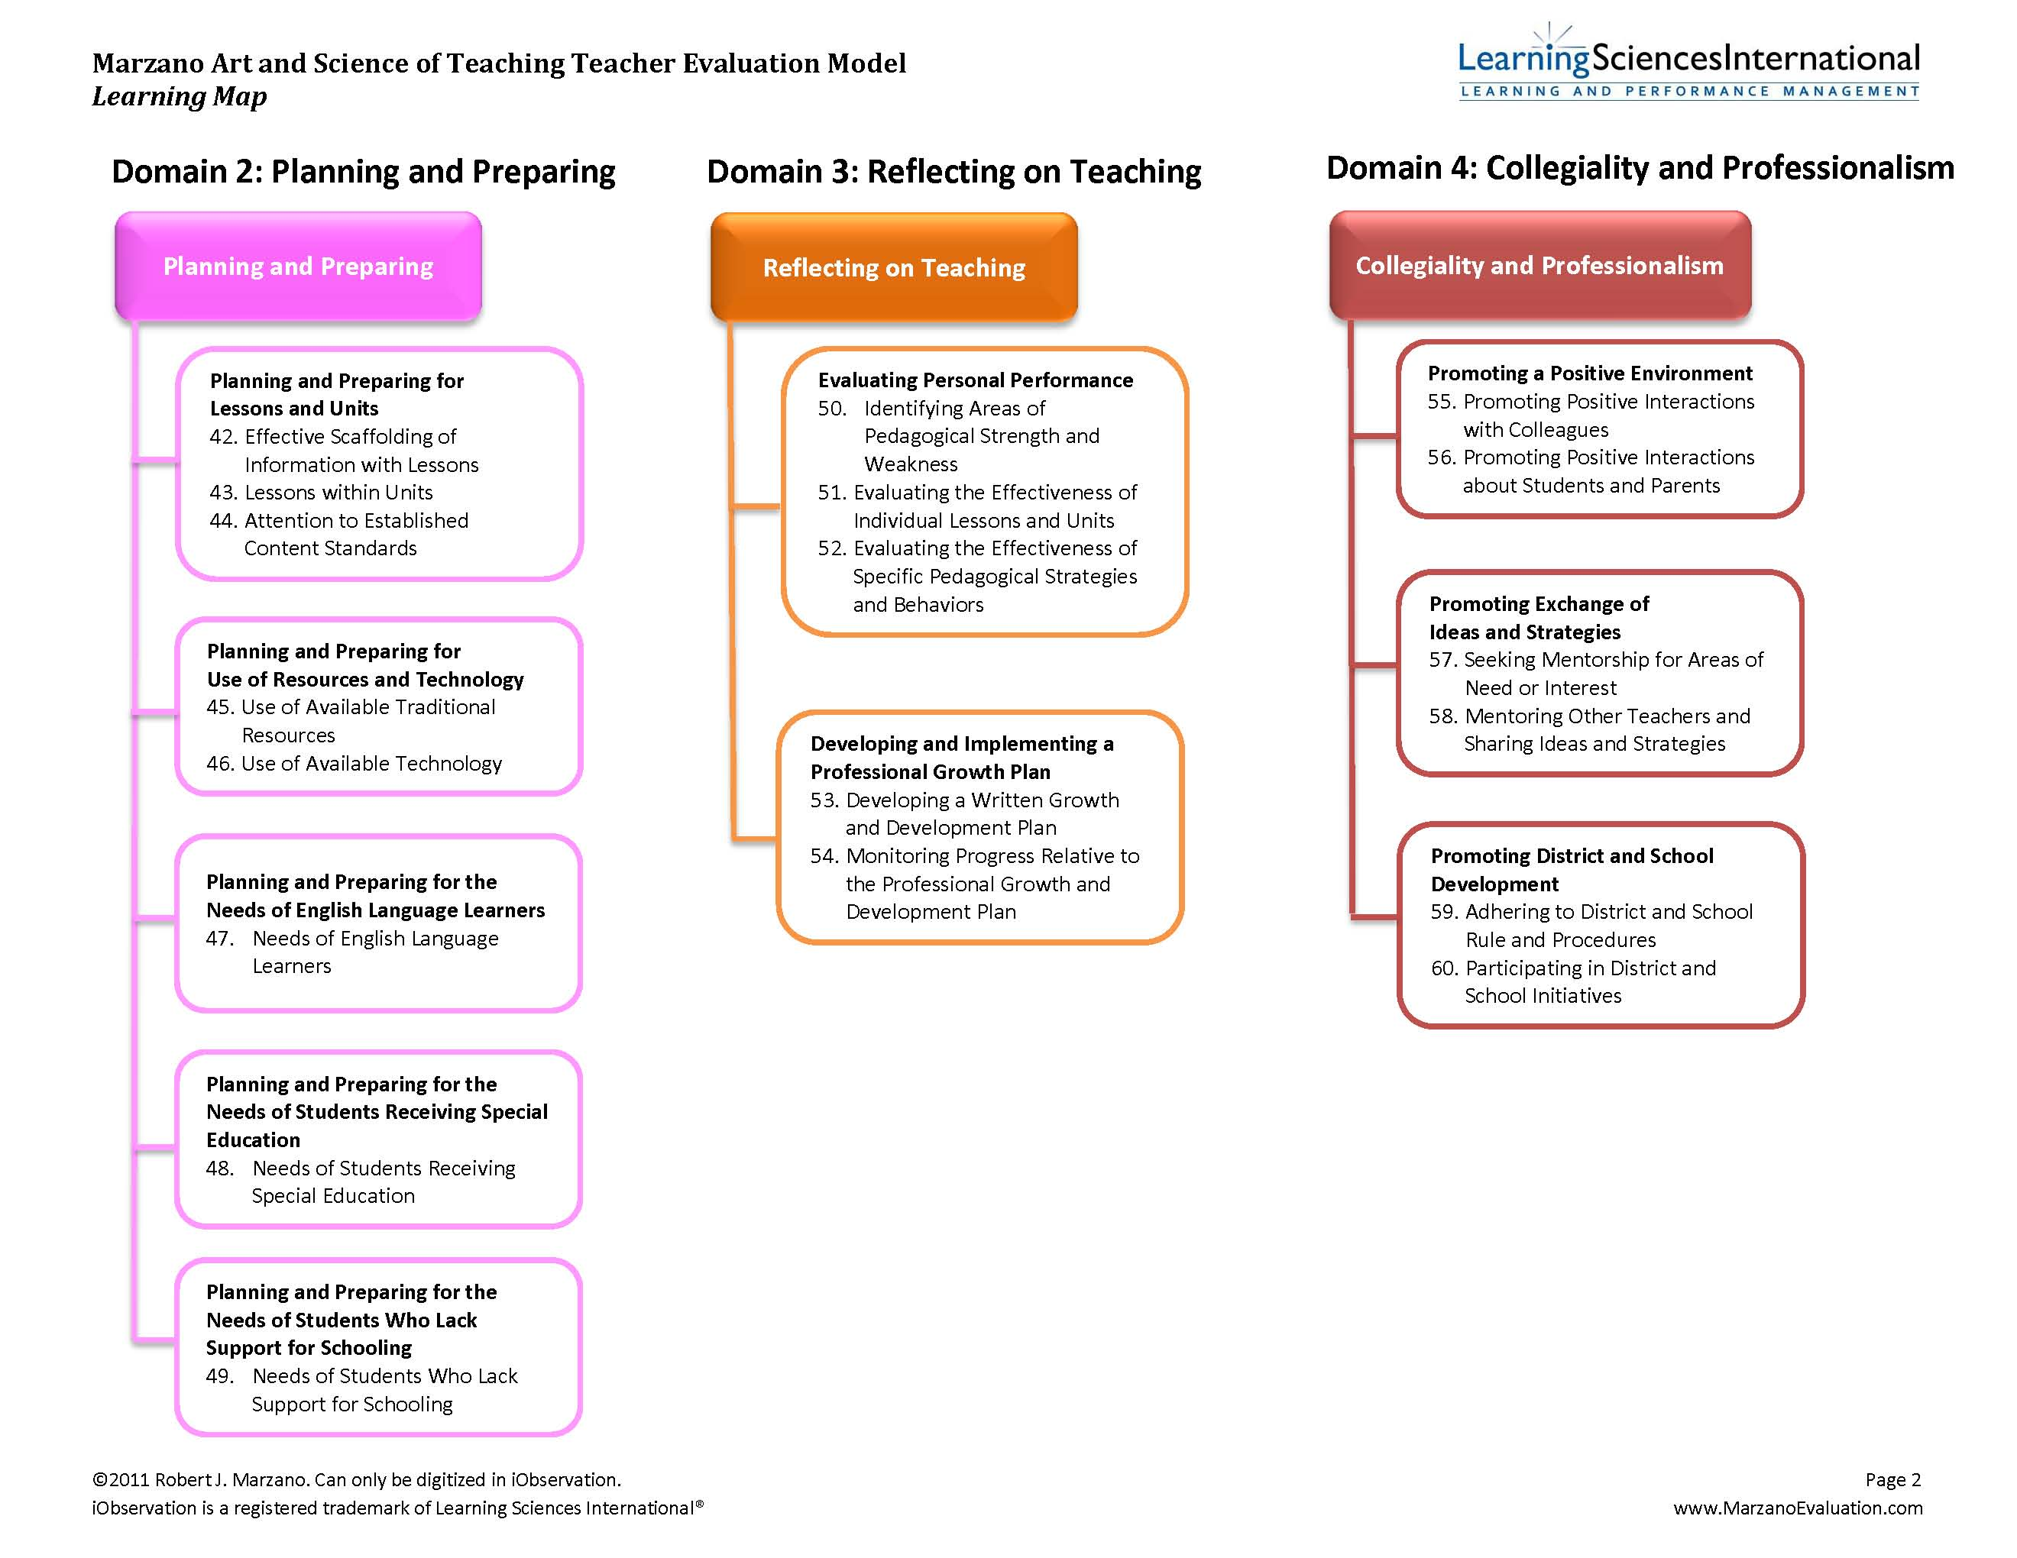
10%
10%
10%

Slide 6
Conjunctive Scoring vs. Average Scoring with Marzano
Averaging vs. Conjunctive
Averaging simply takes the set of scores and figured out what the average is. You get a number between the 0 and 4 if you are using the Marzano observation scale since the lowest number is 0 and the highest number is 4.
Conjunctive scoring is done by setting up rules that determine the level of performance. The score frequencies are compared against a set of rules for each scoring level. If the scores match the rule, then that is the score provided – whatever single number is assigned for the rule.
  Think of it like sorting fruit. You have a box for oranges, a box for kumquats, a box for cherries, and a box for apples. Each fruit is examined and if it meets a certain set of rules it is put in the appropriate container. Oranges should be medium sized and orange, kumquats should be small and orange, cherries should be small and red, and apples should be medium sized and red.
  There is no in-between. The fruit is an orange, a tangerine, a cherry, or an apple. There is not a half cherry/half kumquat - it is either a cherry or a kumquat. You look at the fruit; you reference the rules, and put the fruit in its appropriate place.
  The same idea applies to conjunctive scoring. You either meet the rules for being “Effective - 3” or not. There is no halfway.

Slide 7
Observation #2 for 2013-14
Observations are announced & evaluator meets with teacher for pre-conference prior to observation
Teacher completes pre-observation form in iObservation by identifying 3 to 5 elements from DQ 1 - 5 for the observer & meets with evaluator
Formal observation occurs (NT – 2 Long; T - 1 Long/1 Short)
Evaluator send teacher the reflection form in iObservation to complete & shares observation with teacher
Teacher meets with observer for instructional feedback

Slide 8
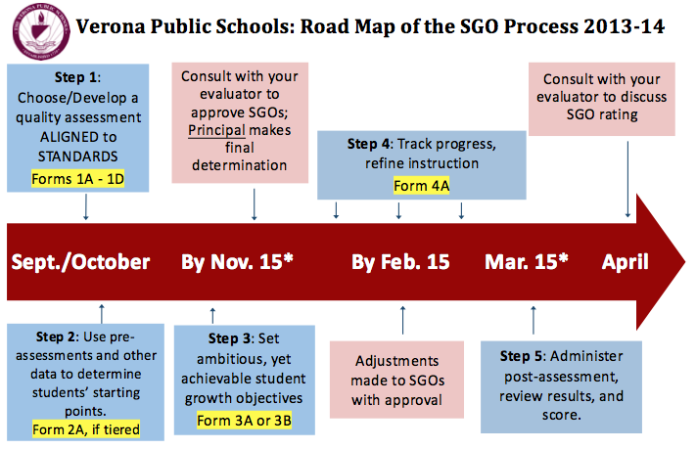
Road Map to Success!

Slide 9
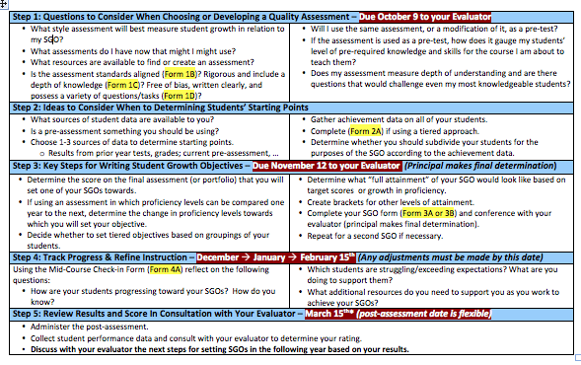
SGO Steps 1 – 5

Slide 10
February 18th: Full Day of PD
February 18: Full Professional Learning/Development Day.
  Items on the agenda:
    Creation of post-test for SGO
    Marzano Student Scale work by building (teacher lead)
    SGP Q&A
    Reviewing & Revising Common Assessments (End of Unit)
      Focus on Rigor, Alignment of Stages 1-2-3 (UbD), Transfer
      PARCC Discussion

Slide 11
Roles of ScIP for each school
Each school is required to convene a School Improvement Panel (ScIP) that includes the principal, an assistant/vice principal, and at least one teacher.
This group must ensure, oversee, and support evaluation, professional development, and mentoring policies within the school (see the AchieveNJ ScIP Overview).
Educators should familiarize themselves with their ScIP and contact ScIP members with questions and feedback about school-level evaluation and support policies.

